Slide 1
Advancements in Machine Learning -Based Spam Detection: From Emails to IoT Devices and Social Media
HARSHIT GOKUL PANT(21BCE5564)
SIDDHARTH SINGH(21BCE5222)
ANKIT KUMAR SINGH(21BCE1247)

Slide 2
INTRODUCTION
The digital era has seen a surge in spam, prompting researchers to turn to machine learning for solutions. This review evaluates the effectiveness of machine learning algorithms in detecting spam across diverse communication platforms. It explores advancements in real-time detection and the integration of deep learning techniques to enhance accuracy. Challenges such as multilingual detection and evolving spam tactics like phishing are also addressed. The aim is to provide insights for bolstering spam mitigation strategies in today's interconnected digital landscape.

Slide 3
LITERATURE SURVEY
It explores the role of machine learning in spam detection across various digital communication platforms. It scrutinizes the efficacy of machine learning algorithms in mitigating spam across email, SMS, social media, and IoT devices.
Furthermore, it addresses the complexities associated with multilingual spam detection and the persistent challenges posed by evolving spam tactics like phishing.
It identifies key research gaps, providing insights crucial for advancing the field of cybersecurity in an era marked by escalating digital threats.
This review contributes to the ongoing discourse surrounding spam mitigation strategies, offering valuable insights for practitioners, researchers, and policymakers

Slide 4
ABSTRACT
This literature review delves into spam detection, emphasizing machine learning's application across various channels like email, SMS, social media, and IoT devices. Evaluating diverse machine learning algorithms, it explores real-time detection advances and deep learning integration for improved accuracy. The review also addresses multilingual spam detection intricacies and evolving tactics such as phishing. By synthesizing existing research, it offers a panoramic view of spam detection technologies, identifies research gaps, and proposes avenues for fortified cyber defenses. This analysis contributes to ongoing discourse on spam mitigation and cybersecurity in today's digitally fraught landscape.

Slide 5
PROBLEM STATEMENT
Adapting existing ML models to new communication formats: Models trained on email data may not effectively identify spam in the vastly different structures and content of IoT messages or social media posts.
Identifying and extracting relevant features: New features specific to each platform (e.g., sensor data in IoT, hashtags in social media) need to be identified and incorporated into the models for accurate spam detection.
Combating the evolving tactics of spammers: Spammers constantly adapt their methods, requiring the development of dynamic and continuously learning models to stay ahead.

Slide 6
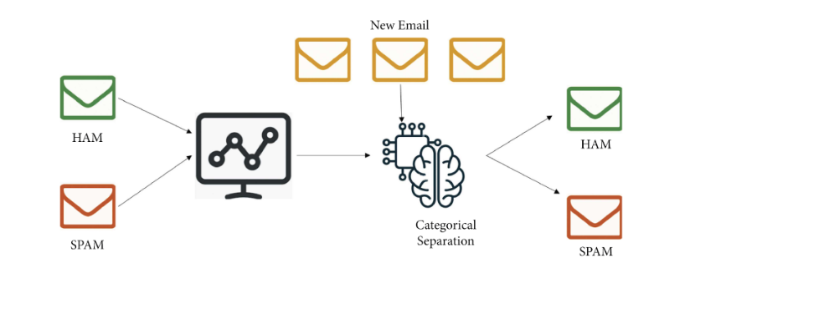
ARCHITECTURE DIAGRAM

Slide 7
REFERENCES
Paper Number | Author(s) | Publication Date | Publication | Title | DOI Link
1 | Fahimeh Ramezani, Reza Javidan | 2022 | Journal of Information Security and Applications | Phishing Detection System Through Hybrid Machine Learning Based on URL | DOI
2 | Ibrahim M. H. Eraqi, et al. | 2020 | Expert Systems With Applications | A deep learning method for automatic SMS spam classification: Performance of learning algorithms on indigenous dataset | DOI
3 | K. R. Uday, et al. | 2019 | International Journal of Innovative Technology and Exploring Engineering | SMS Spam Detection Using Machine Learning | DOI
4 | M. K. Gupta, et al. | 2022 | Journal of Cyber Security and Mobility | An Intelligent Framework Based on Deep Learning for SMS and e-mail Spam Detection | DOI
5 | Sanjay Kumar, et al. | 2021 | Journal of Information Security and Applications | AN EFFICIENT SPAM DETECTION ON IOT DEVICES USING MACHINE LEARNING | DOI

Slide 8
CONCLUSION
With the right tools and techniques, it is possible to build highly effective spam mail detection systems using machine learning. By leveraging the power of these techniques, we can help protect individuals and organizations from the growing threat of spam and other email-based attacks.

